Slide 1
Python Basics - NumPy and Pandas

Slide 2
Learning Objectives
Installation Steps
Data Types in Python
Numpy
Pandas
Case Study
‹#›

Slide 3
Python ( What and Why ?)
Python is the most popular programming language & choice for Data Scientist / Data Engineer across the world
Very rich libraries & functions
Community support
Easy to deploy in production
Support for all the new state of the art technologies ( like deep learning)
‹#›

Slide 4
Installation Steps
Install using the instruction given in the below links - 1. Install Jupyter - http://jupyter.org/install Preferred installation method is through Anaconda distribution.
Install Python 3.6 version. 2. Anaconda 5.2 For Linux Installer - https://www.anaconda.com/download/#linux 3. Anaconda 5.2 For macOS Installer - https://www.anaconda.com/download/#macos 4. Anaconda 5.2 For Windows Installer - https://www.anaconda.com/download/#windows (You need to download the version compatible with your OS)
‹#›

Slide 5
Common python libraries
NumPy – handling multi-dimensional arrays
Scipy – Statistical package
Matplotlib, seaborn – Visualisation
Pandas – handling arrays & dataframes

Slide 6
Types of common variables
Integer
Float
String
Logical

Slide 7
Data Types in Python
Apart from data types like int, string, float Python has the below data types which are very useful for data science -
List
Tuples
Dictionaries
‹#›

Slide 8
Python data structures - List vs Tuple vs Dictionary
Both list & tuples are ordered sequence of objects
Both can contain mixed data types
List is mutable while a tuple is like a list but immutable
Tuples are faster and consume less memory
Dictionary list of items in terms of a key and a value

Slide 9
Numpy
NumPy is the fundamental package for scientific computing with Python.
It contains -
a powerful N-dimensional array object - ndarray
sophisticated (broadcasting) functions
useful linear algebra, Fourier transform, and random number capabilities etc.
Refer - http://www.numpy.org/

Slide 10
Pandas
A library written for the Python programming language for data manipulation and analysis.
In particular, it offers data structures and operations for manipulating numerical tables and dataframes.

Slide 11
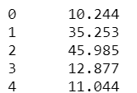
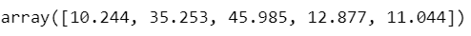
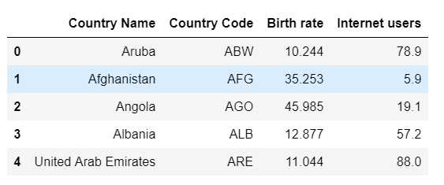
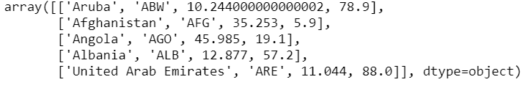
Practical example of the usage of dataframe, series & array on a dataset
Extract Birth rate as Pandas Series
Demographic data
Country Name | Birth rate | Internet users | Income Group
Aruba | 10.244 | 78.9 | High income
Afghanistan | 35.253 | 5.9 | Low income
Angola | 45.985 | 19.1 | Upper middle income
Albania | 12.877 | 57.2 | Upper middle income
United Arab Emirates | 11.044 | 88 | High income
Convert to dataframe
Extract birth rate as numpy array
Convert dataframe to numpy array

Slide 12
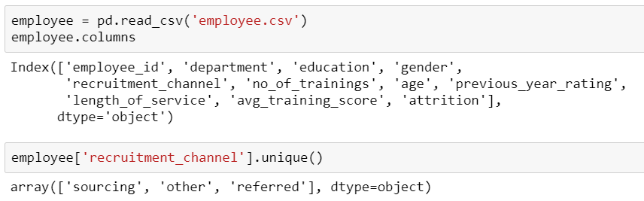
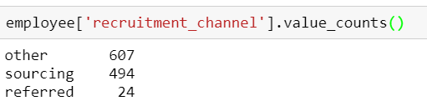
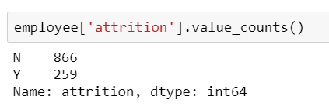
Typical use cases for unique & valuecount
Mainly used in understanding proportions of levels of a categorical variable
value_count – proportion of employees recruited from each recruitment source
unique - What are the sources of recruitment in the dataset
value_count – proportion of attrition in a dataset

Slide 13
Typical use cases of a python dictionary
Use whenever a mapping from a key to a value is required
mapping a field Unique ID to their human-friendly labels
dictionary of genres in a movie database
Sentiment analysis
{'id': 28, 'name': 'Action'}, {'id': 35, 'name': 'Comedy'}, {'id': 10402, 'name': 'Music'}, {'id': 10751, 'name': 'Family'}, {'id': 12, 'name': 'Adventure’}
based on dictionary of positive & negative words

Slide 14
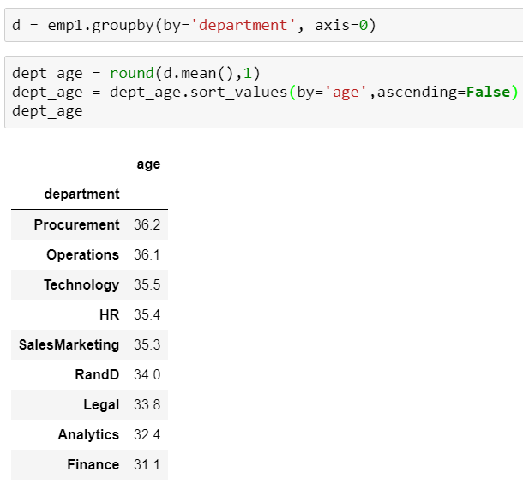
Application of group by
Similar to pivot tables in excel
What is the average age of employees in each department in the employee dataset?
What is the highest rating a movie has received in the genre “comedy”?

Slide 15
Merge vs Join
Merge – merges 2 df using a unique column identifier (primary key)
Join – to join 2 dataframes by the index

Slide 16
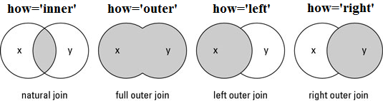
Types of merge
Natural join - Intersection
Full outer join - Union
Left outer join
Right outer join
To keep only rows that match from the data frames, specify the argument how=‘inner’.
To keep all rows from both data frames, specify how=‘outer’.
To include all the rows of your data frame x and only those from y that match, specify how=‘left’.
To include all the rows of your data frame y and only those from x that match, specify how=‘right’.

Slide 17
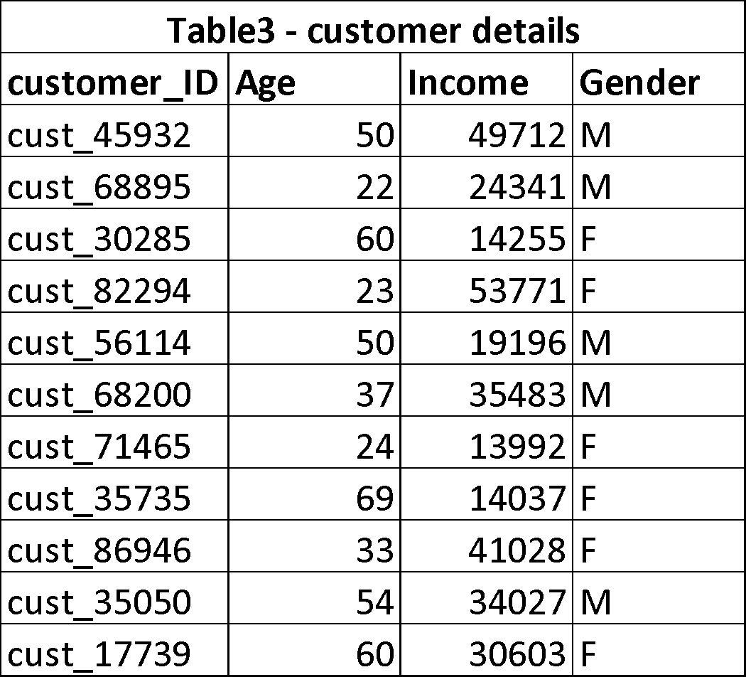
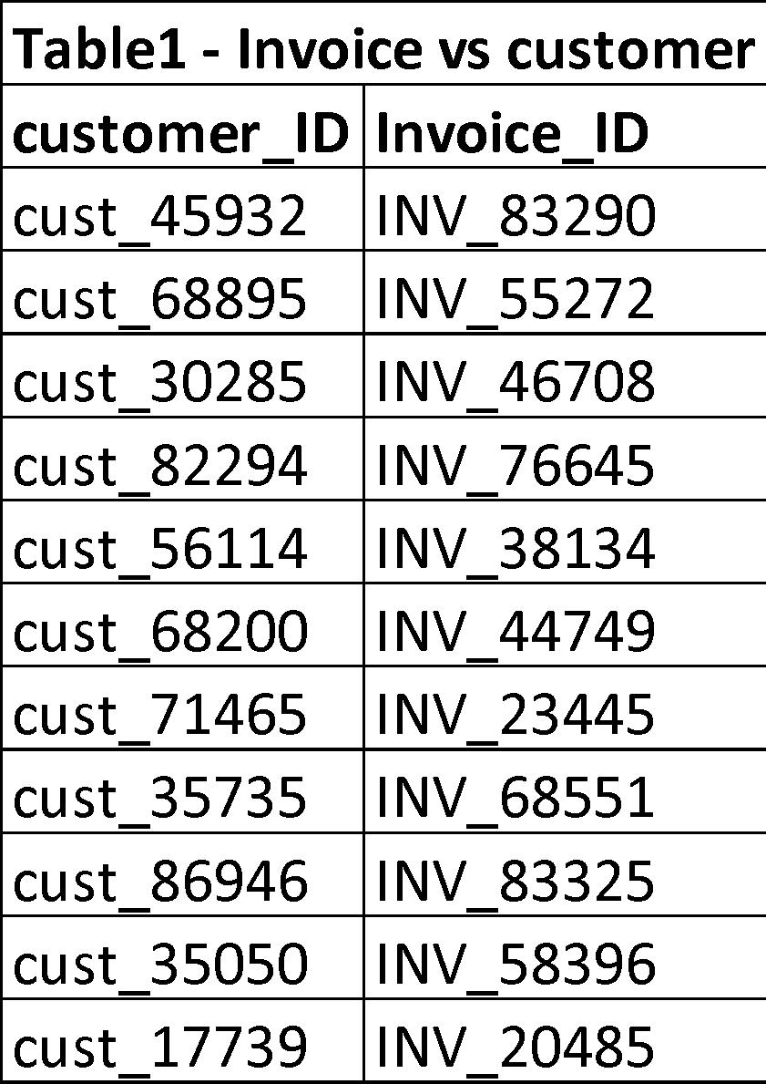
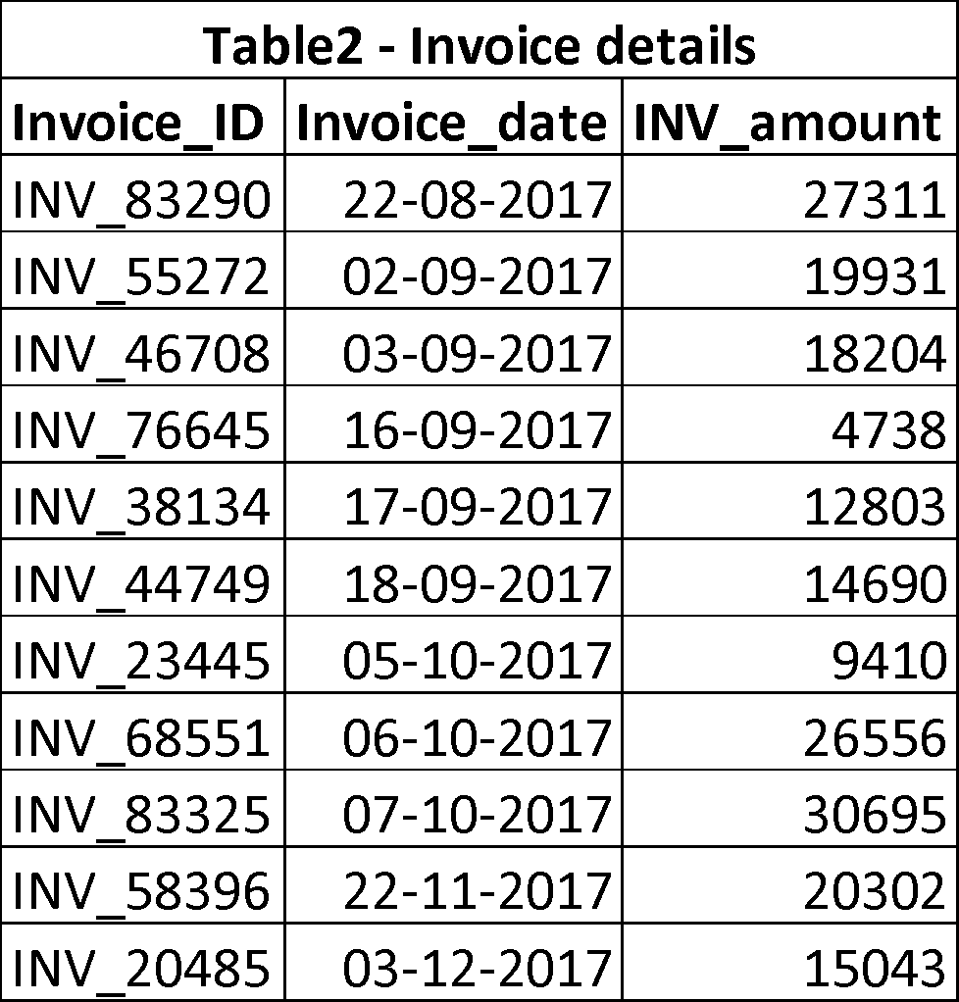
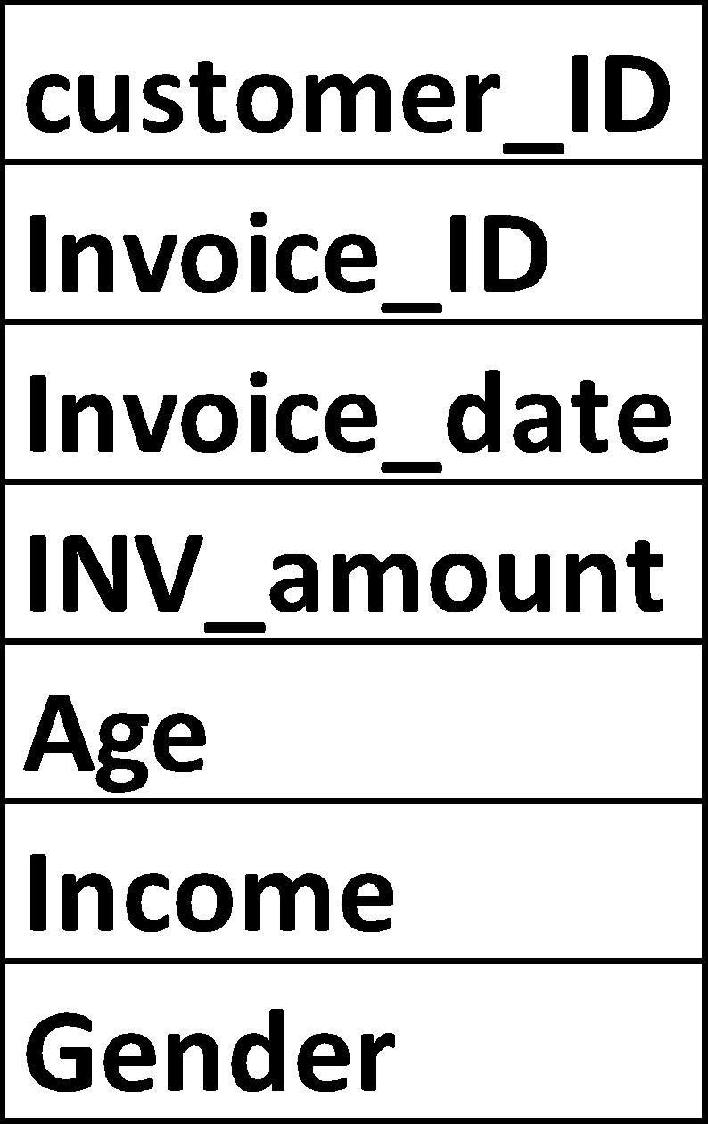
Uses of Merge & Join
Create a transactional dataframe per customer to analyse purchasing patterns according to customer demography

Slide 18
Case Study
Uber Drive Data Analysis -
The data of a driver’s uber trips are available for year 2016.
Your manager wants you to explore this data to give him some useful insights about the trip behaviour of a Uber driver.
Dataset -
The dataset contains Start Date, End Date, Start Location, End Location, Miles Driven and Purpose of drive (Business, Personal, Meals, Errands, Meetings, Customer Support etc.)

Slide 19
Steps
1. Import the libraries 2.Get the data and observe it 3.Check missing values, either remove it or fill it. 4.Get summary of data using python function. 5.Explore the data parameter wise Here we have information of destination(start and stop), time(start and stop), category and purpose of trip, miles covered.

Slide 20


Questions?

